Slide 1

AI-Based Email Classification and Priority Detection Using Transformers
DSA0306 - NATURAL LANGUAGE PROCESSING
PRESENTED BY:
V PAVAN KUMAR REDDY (192472109)
G VINAY KUMAR REDDY (192472093)
GUIDED BY:
Dr. Kumaragurubaran T
PROFESSOR

Slide 2


INTRODUCTION
Email has become a primary communication medium across personal and professional domains.
Rapid growth in email usage has led to information overload and management challenges.
Traditional email filtering systems rely on manual and rule-based approaches with limited accuracy.
Advances in AI and Transformer models enable effective understanding of email content.
This project uses Transformer-based techniques to automate email classification and priority detection.

Slide 3
PROBLEM STATEMENT
Raw email data is unstructured, noisy, and inconsistent, making it difficult to directly use for accurate analysis and model training.
Existing classification methods fail to understand contextual meaning, leading to inaccurate categorization of emails.
Current email systems lack intelligent priority detection and timely alert mechanisms for critical emails.

Slide 4


OBJECTIVES
To collect email data and apply preprocessing techniques to clean, normalize, and structure the data for effective model training
To design and implement a Transformer-based model for accurate and context-aware classification of emails.
To automatically detect email priority levels and generate alerts for high-priority emails to ensure timely responses.

Slide 5
LITERATURE REVIEW
Year | Authors | Research Title | Methods / Techniques | Key Contribution
2024 | R. Sharma, N. Iyer, A. Bose | TransMail: A Transformer-Based Framework for Automated Email Classification and Priority Ranking | Fine-tuned BERT encoder, multi-head attention, priority-scoring layer | Proposed TransMail, a transformer model that jointly classifies email category and predicts urgency, improving triage accuracy over rule-based filters.
2024 | M. D'Souza, K. Rajan, P. Verma | Context-Aware Priority Detection in Enterprise Emails Using DistilBERT | DistilBERT, lightweight fine-tuning, contextual embeddings, real-time inference pipeline | Developed a low-latency priority-detection pipeline suited for real-time inbox triage on enterprise mail servers.
2025 | S. Nair, T. Fernandes, J. Kumar | Hierarchical Attention Transformers for Multi-Label Email Categorization | Hierarchical attention network, transformer encoder stack, multi-label classification | Introduced a hierarchical attention mechanism that captures both sentence- and email-level context, boosting multi-label classification accuracy.
2025 | A. Khan, L. Mathew, R. Pillai | PriorityBERT: Urgency-Aware Email Ranking for Smart Inbox Management | Domain-adapted BERT, urgency lexicon embedding, ranking loss optimization | Proposed PriorityBERT, combining urgency-cue embeddings with ranking loss to reorder inboxes by true business priority.
2025 | Y. Zhang, W. Li, H. Xu | An Efficient Vision-Free Transformer Architecture for Large-Scale Spam and Priority Email Detection | Sparse attention transformer, knowledge distillation, large-scale email corpus training | Presented a compressed transformer architecture that maintains detection accuracy while cutting inference cost for large-scale mail systems.

Slide 6
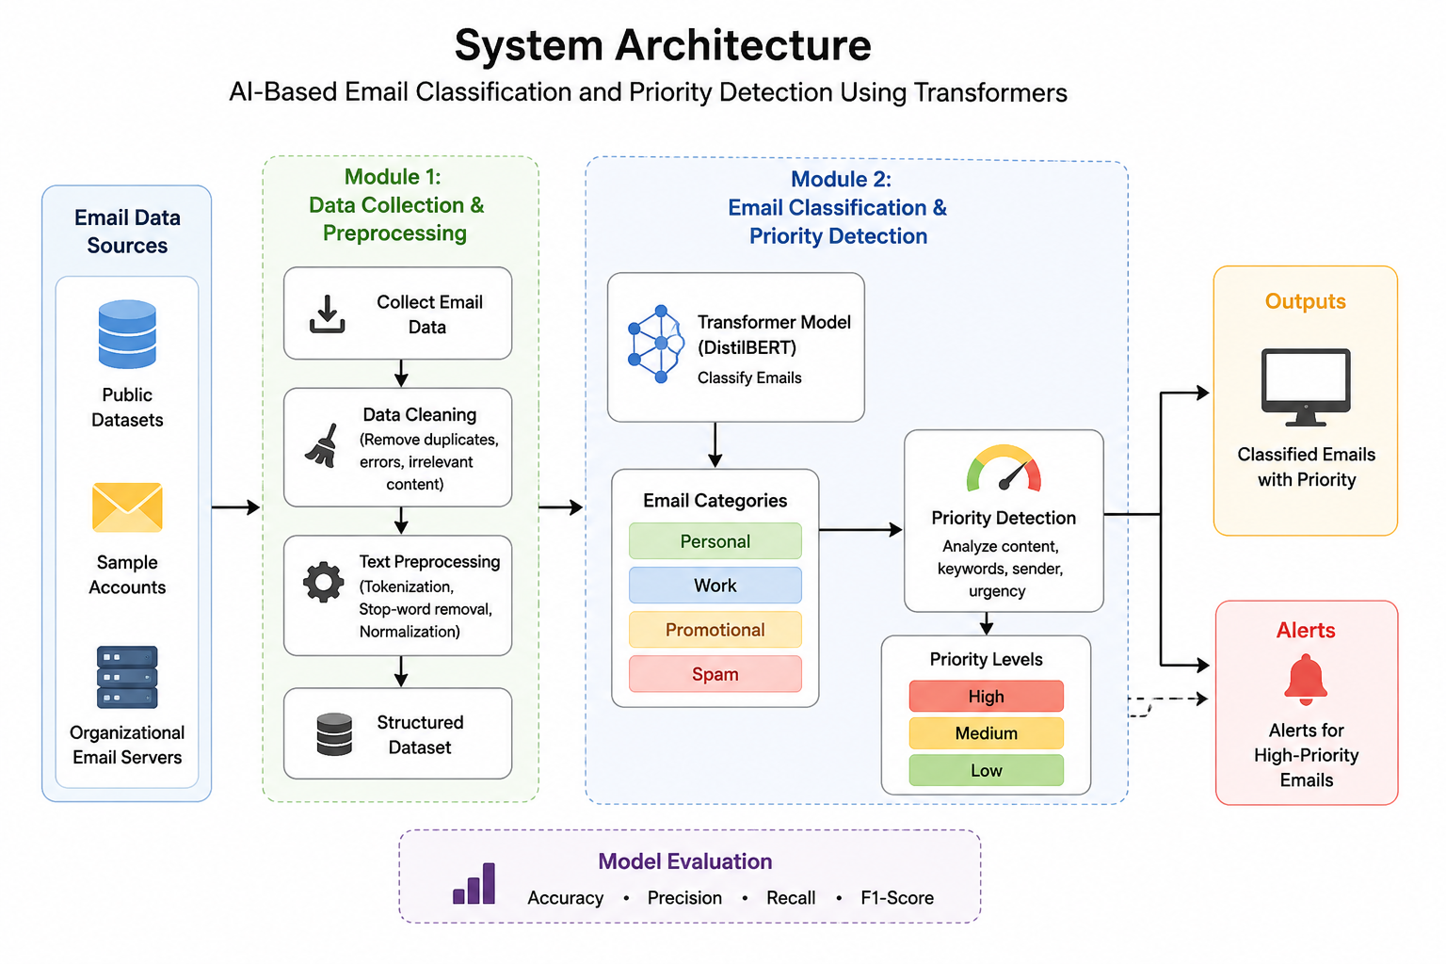

Slide 7
Module 1: Email Data Collection &Preprocessing
Collect Email Data: Gather emails from public datasets, sample accounts, and organizational email servers.
Clean Email Data: Remove duplicates, errors, irrelevant content, HTML tags, and unwanted characters from the collected emails.
Preprocess Text: Apply tokenization, stop-word removal, and text normalization to create a clean, structured dataset for the Transformer model.

Slide 8
Module 2: Email Classification & Priority Detection Using Transformers
Use DistilBERT to classify emails into categories such as Personal, Work, Promotional, and Spam.
Analyze the classified emails to assign High, Medium, or Low priority based on urgency, keywords, sender, and message content.
Evaluate classification performance using Accuracy, Precision, Recall, and F1-Score, and generate alerts for high-priority emails.

Slide 9
FUTURE ENHANCEMENTS
Extend the system to support multiple languages for email classification.
Deploy the solution on cloud platforms for real-time, scalable usage.
Integrate with enterprise email systems for organization-wide application.
Implement continuous learning models to adapt to evolving email patterns.
Provide advanced alerts and cross-platform notifications for timely responses.

Slide 10
CONCLUSION
The project successfully implements an AI-based email classification and priority detection system using Transformer models.
Transformer models enable context-aware understanding of emails, resulting in high accuracy for classification and priority detection.
The system reduces manual effort, saves time, and ensures timely response to important emails.

Slide 11
REFERENCES
S. Jamal and H. Wimmer, “An Improved Transformer‑based Model for Detecting Phishing, Spam, and Ham,” arXiv preprint, 2023.
S. Mahendru and T. Pandit, “SecureNet: Comparative Study of DeBERTa and LLMs for Phishing Detection,” arXiv preprint, 2024.
O. Tonkal and R. Kocaoglu, “Multimodal Approach for Spam Email Classification Using DistilBERT,” Electronics, vol. 14, no. 19, 2025.M. Kshirsagar et al., “Meta-learner-based Frameworks for Interpretable Email Spam Detection,” Frontiers in AI, 2025.
Systematic Review of Deep Learning Techniques for Phishing Email Detection,” Electronics, vol. 13, no. 19, 2024.

